Slide 1

Advanced Topics in Computer Networks Capture & Decode LoRa Signals
Iliadis Ilias 2523 Lamprinos Isidoros 2551

Slide 2
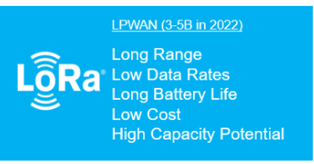
LoRa characteristics
What is LoRa?
Low-power wide-area network modulation technique
It provides long-range communications
Accommodates vast range of IoT applications

Slide 3
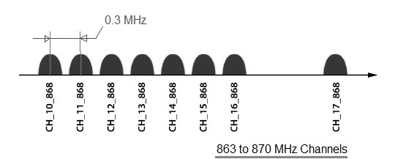
LoRa frequency bands
Europe: 433MHz and 868MHz
Australia and North America: 915MHz
Asia: 923 MHz

Slide 4
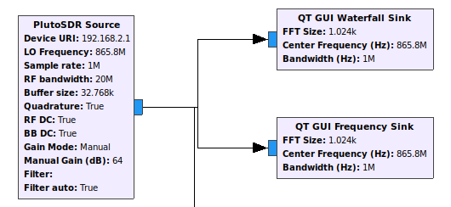
Identify Transmission Frequency
The device we used in order to implement this project is Adalm-Pluto SDR
Used Blocks:
QT GUI Waterfall Sink
QT GUI Frequency Sink

Slide 5
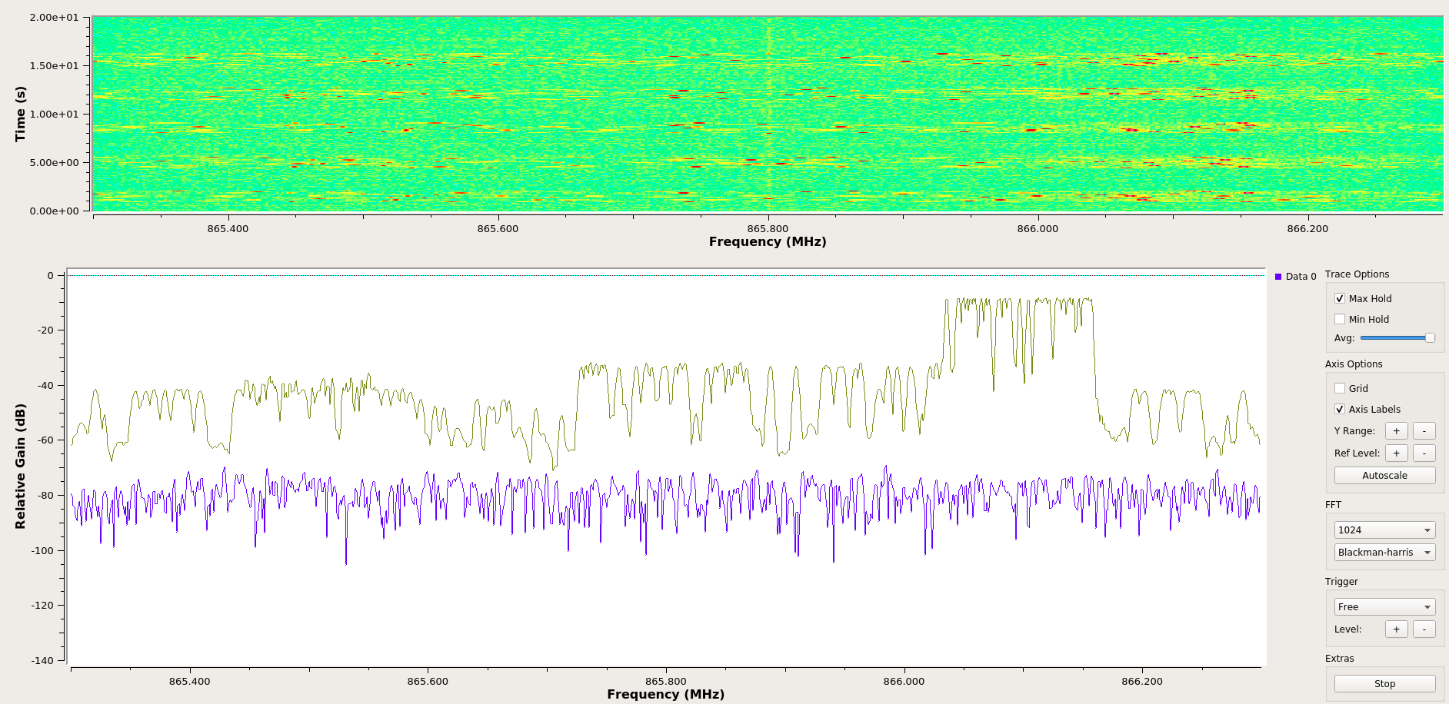

Slide 6
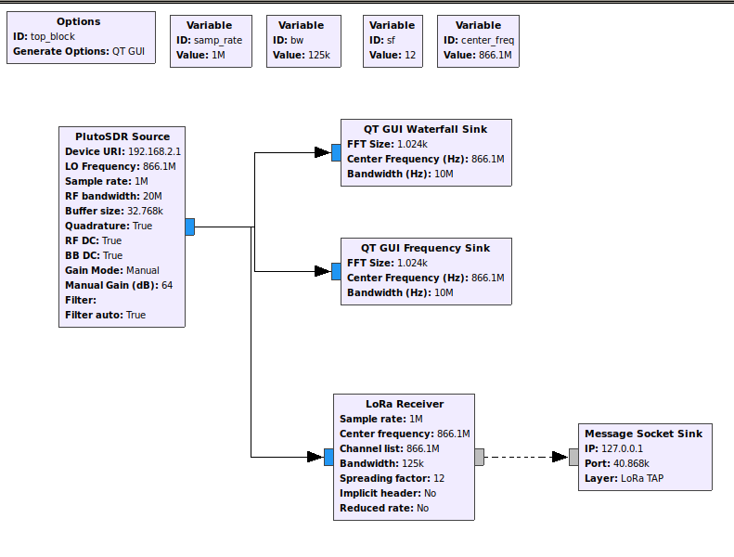
Demodulating Captured Signals
Schema used for real time LoRa signal demodulation

Slide 7
Modulation Parameters
Coding Rate(CR):
Amount of redundant bits added for error correction(FEC)
Bandwidth(BW):
Frequency Width
Higher BW Higher Data Rate, Lower Sensitivity
Spreading Factor(SF):
SF range: 7-12
Larger SF Higher processing Gain , Longer Transmission Rang

Slide 8
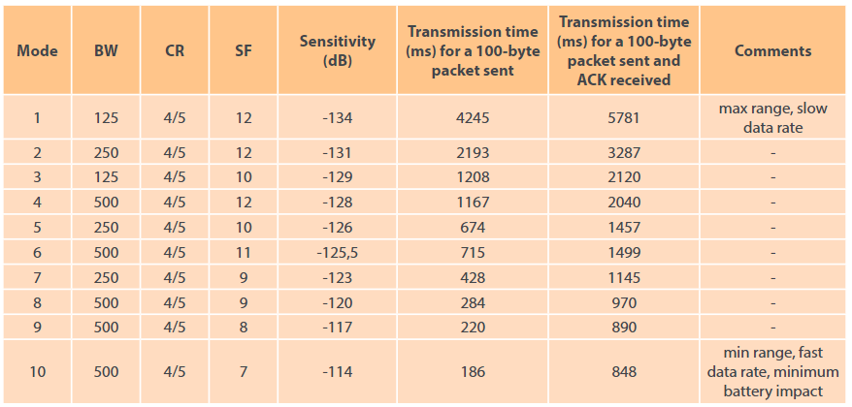
LoRa Transmission Modes (1/2)

Slide 9

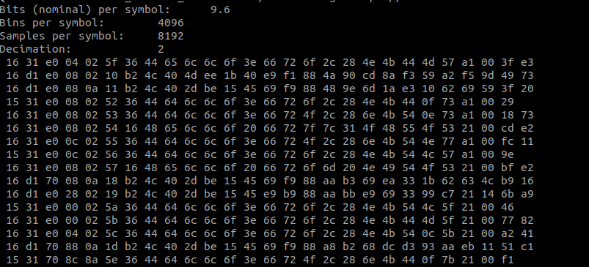
LoRa Transmission Modes (2/2)
We manually changed the SF and BW in order to find the current transmission mode

Slide 10
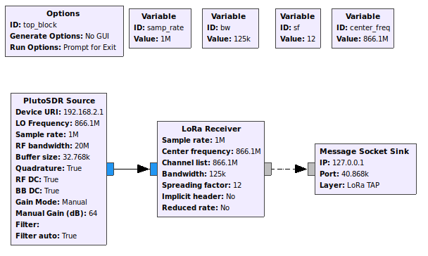
Dynamic Implementation
This GRC schema is the one we used to produce the python file that we used to implement the dynamic algorithm of our project.

Slide 11
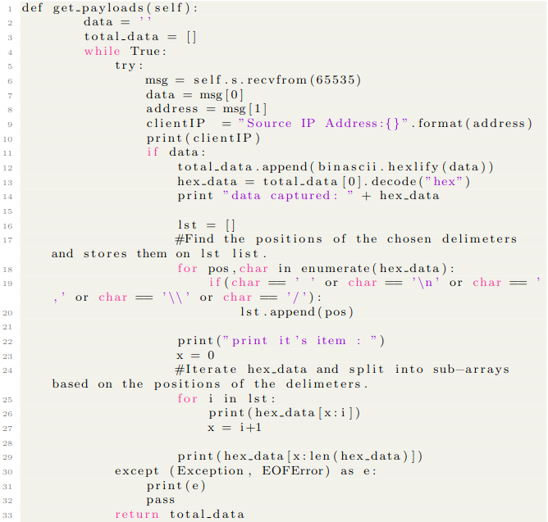
Decoding
Listening to port 40868 for 20”
If no data captured change mode
Else continue listening
Get source IP address and port from msg[1]
Unhexlify data and search for delimiters

Slide 12
Experiment Results
On modes 8,9,10 BW is set to 500kHz and corrupted packets are frequently observed. For modes 8,9 distance between receiver and transmitter affects the packet correctness.
In mode 6 we seldom observe any transmission.
Modes with BW 250kHz and mode 3 with BW 125kHz are the most reliable for correct transmission.
In mode 1 if the distance between transmitter and receiver is lower than 1.5m no transmission is detected.

Slide 13
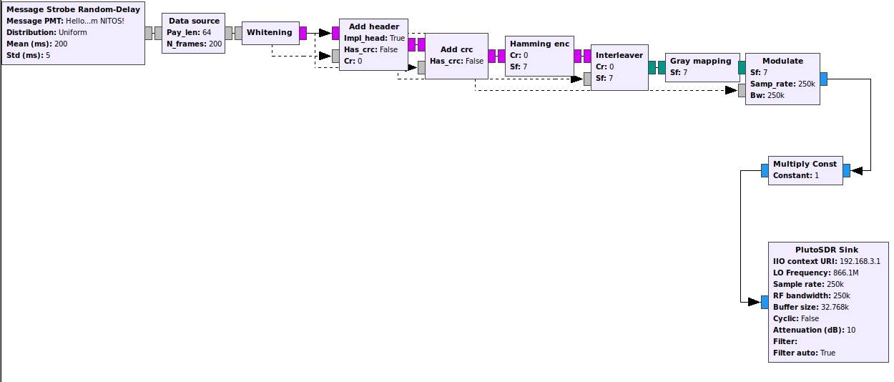
Future Work/LoRa Transmitter

Slide 14
Thank you for your attention
Any Questions?

